Slide 1
Perinatal and intrauterine infection – what’s new
Dr Conor Doherty
Paediatric Infectious Diseases and Immunology
RHC Glasgow

Slide 2
Plan
Perinatal vs intra-uterine transmission
What have we learned from HIV/Hep B and how can we apply to Hep C
CMV update

Slide 3
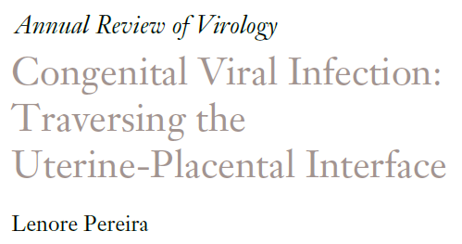
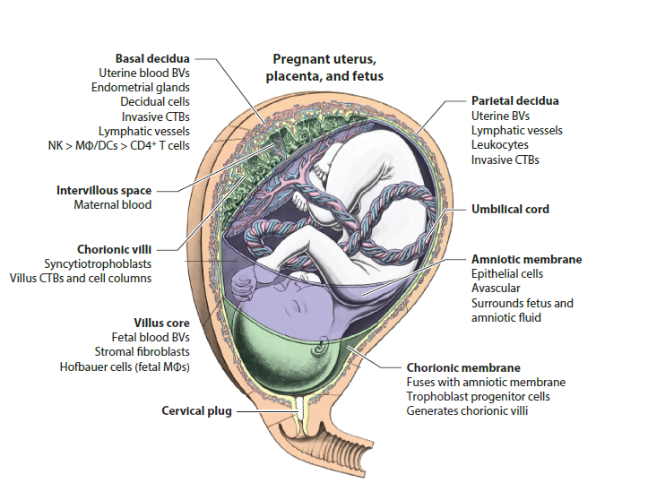
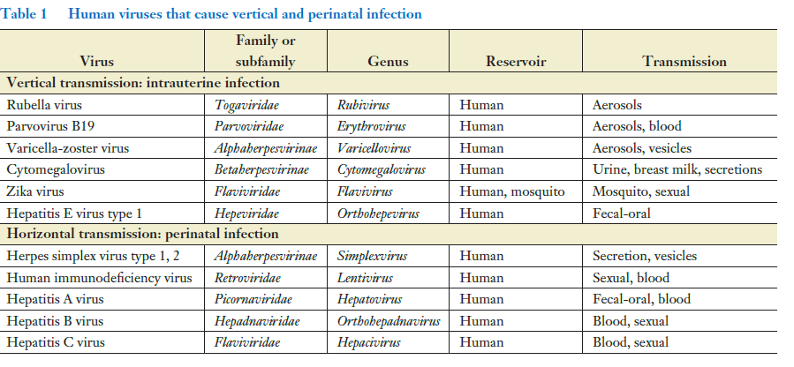

Slide 4



Mother to child transmission
Primary prevention, PMTCT during pregnancy, treatment of infected baby

Slide 5
Blood borne viruses

Slide 6
Scotland and pregnancies affected by blood borne viruses
 | HIV | Hep B | Hep C
Scotland total numbers | 5,500 | 5,000 | 21,000
No of affected pregnancies per year | 30-40 declining | 113 stable | 88* declining
Infected children/adolescents | 30 | 38 | 72*

Slide 7
HIV
 | HIV
Antenatal seroprevalence | 0.1-0.2%
Routine antenatal screening | ✓
Transmission rate s intervention | 20-40%
Chronicity vs adult acquisition | 100% vs 100%
Effective MTCPT | ✓
Transmission rate post MTCPT | 0.1%
Curative treatment | ✗
Immunisation | ✗

Slide 8
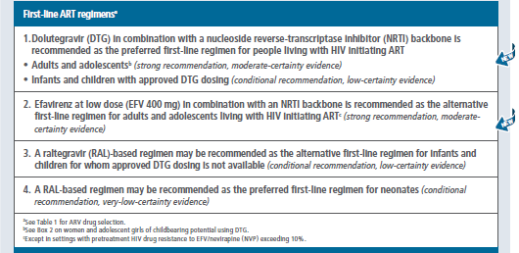
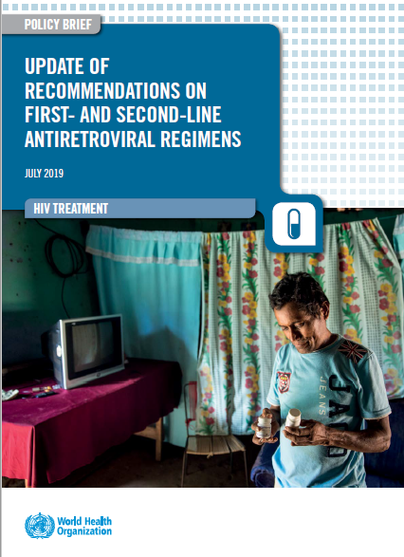

2019 WHO recommendations: First-line ART regimens

Slide 9
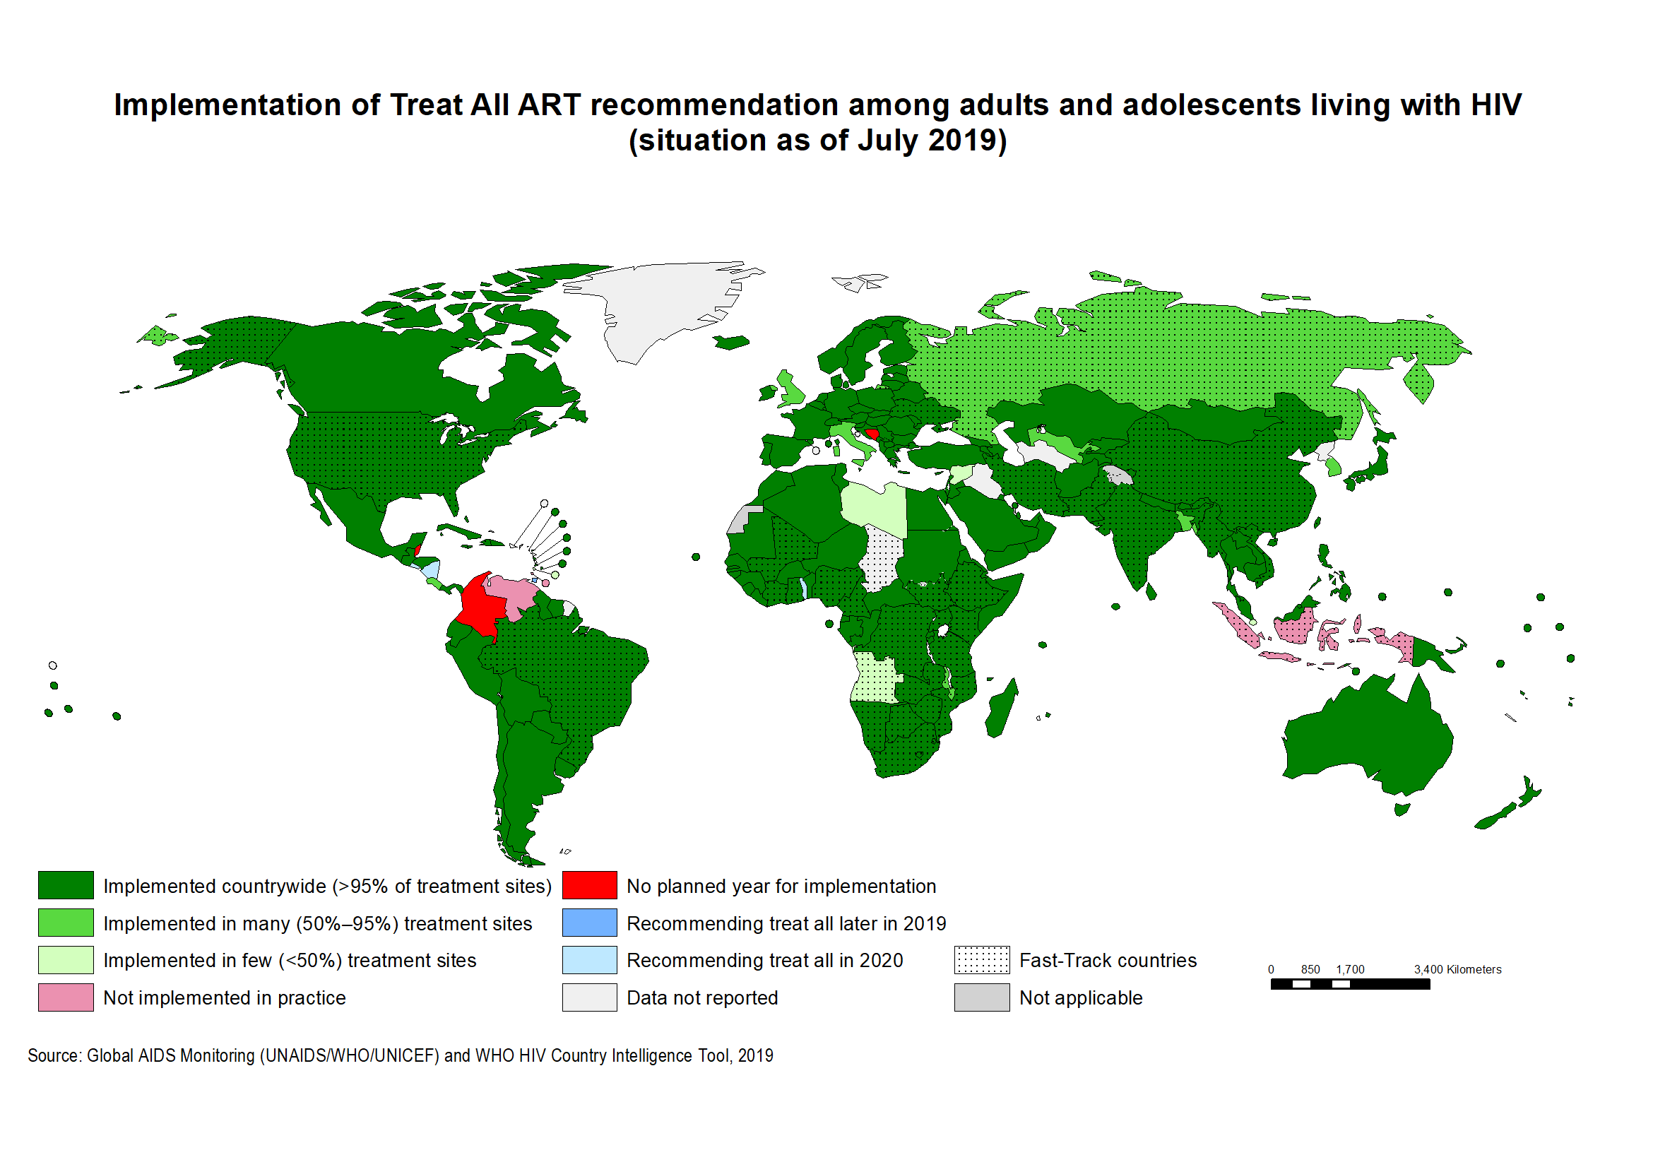
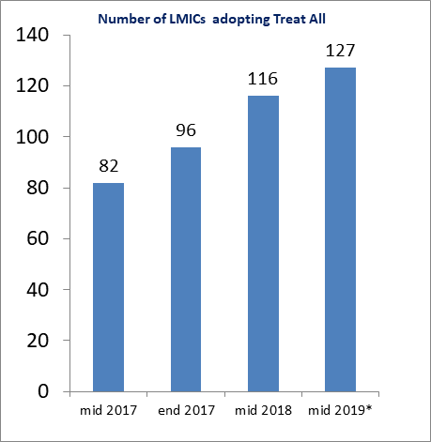
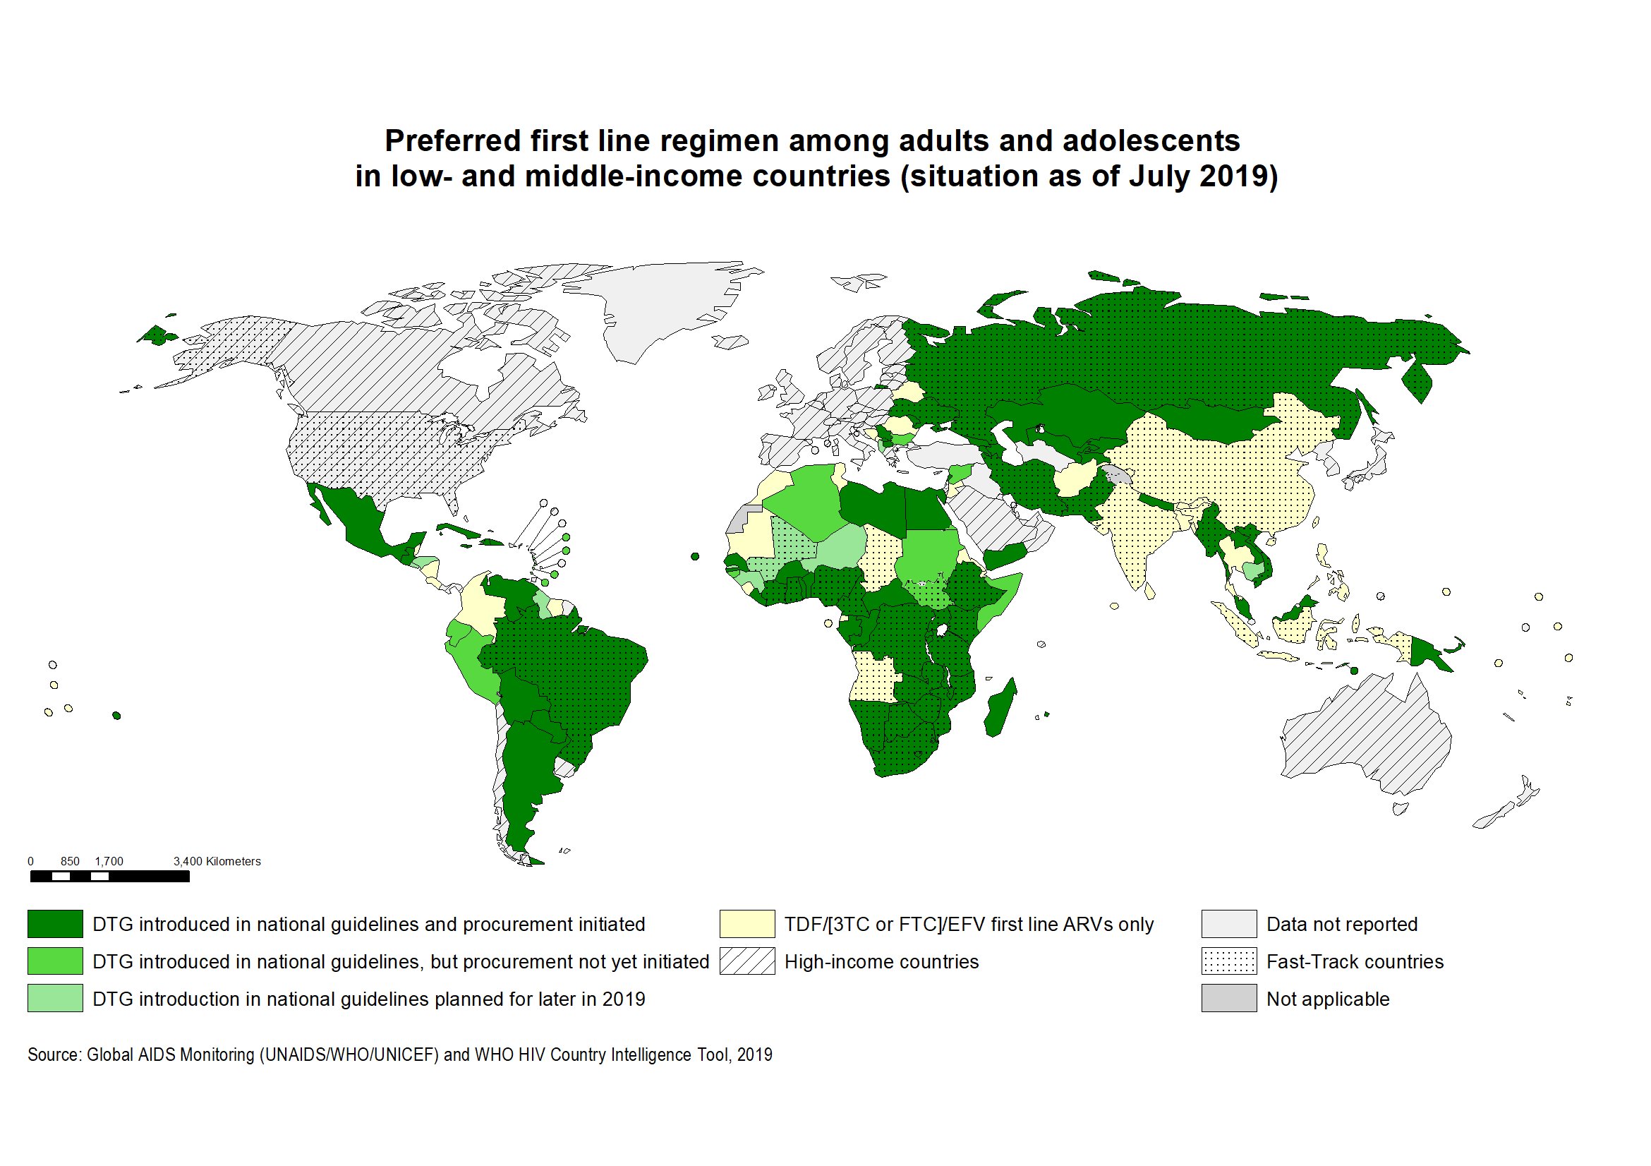
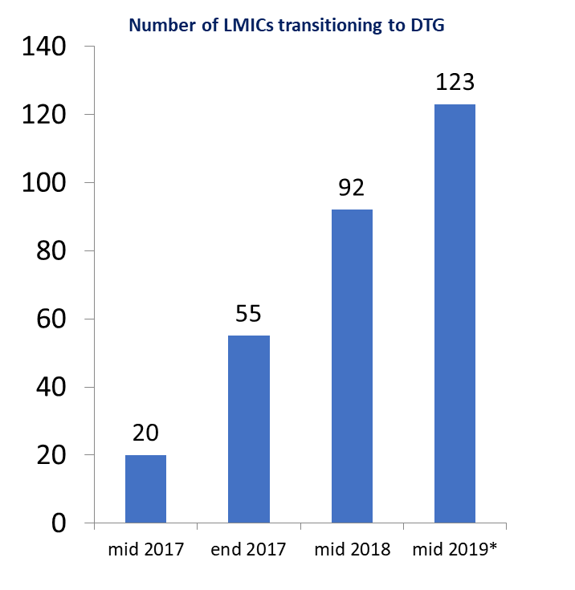
Uptake of major HIV treatment policies in LMICs
Treat All
DTG transition
* Preliminary data

Slide 10

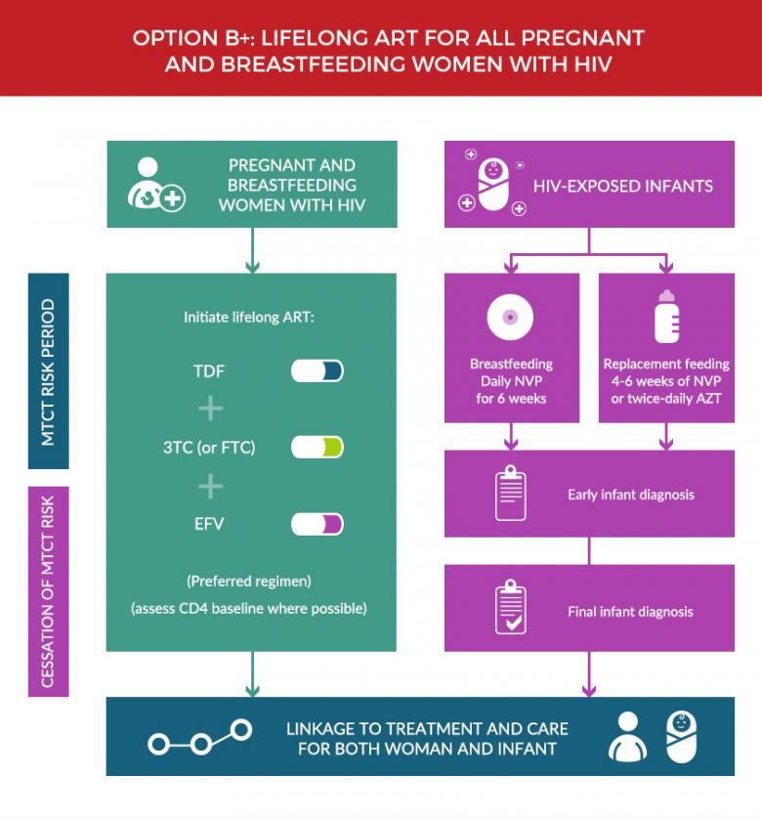
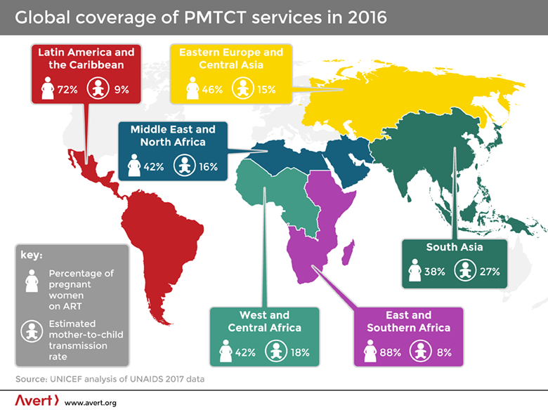
WHO & PMTCT
Since 2010, 1.4 million infections among children averted by PMTCT programs
48% decline in new child infections among the 23 UNAIDS priority countries

Slide 11
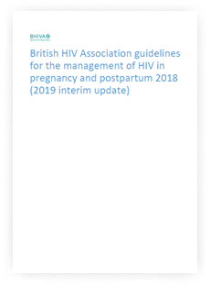

HIV & PMTCT in Scotland
https://www.spaiin.scot.nhs.uk/perinatal-hiv-care-pathway/

Slide 12
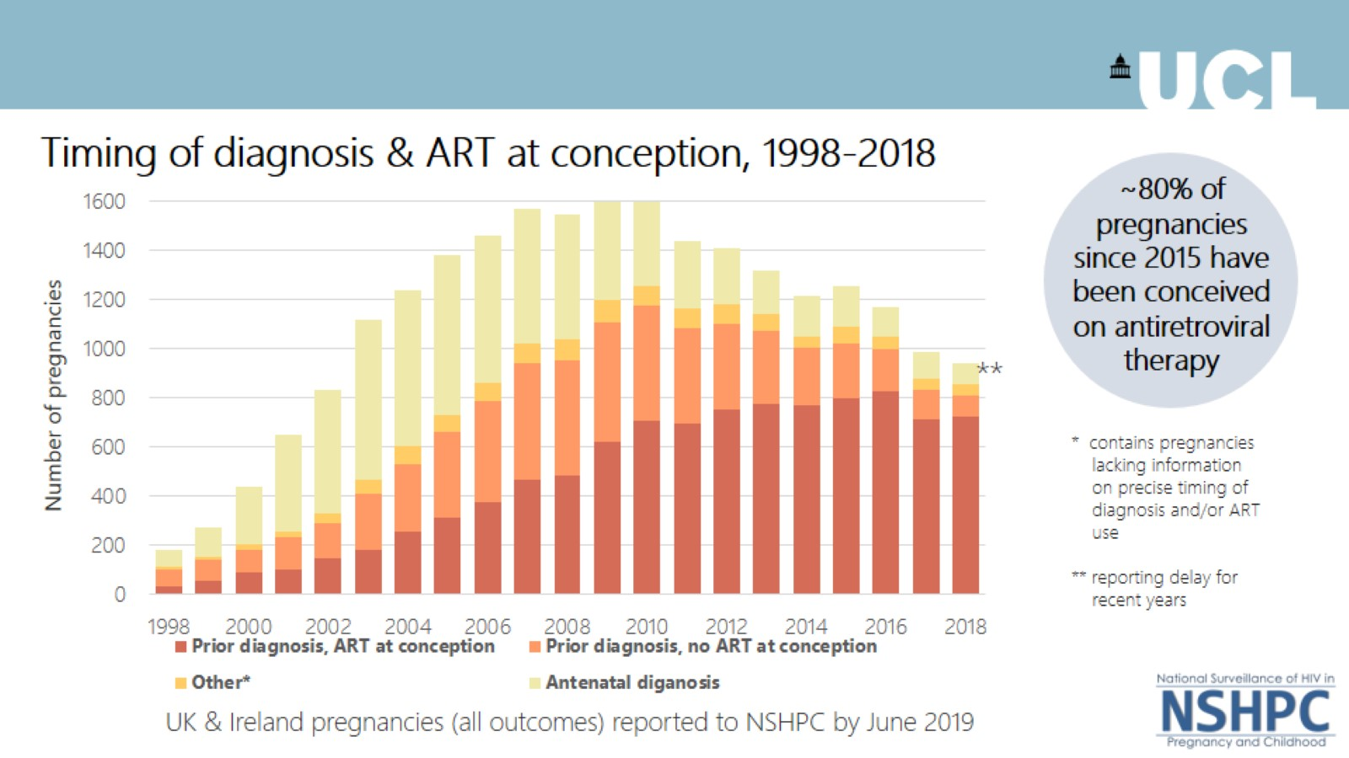

Slide 13
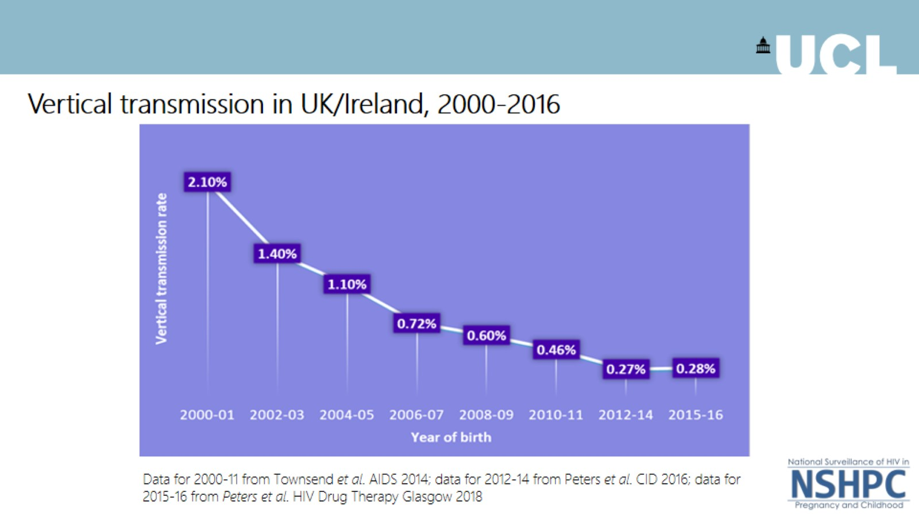

Slide 14
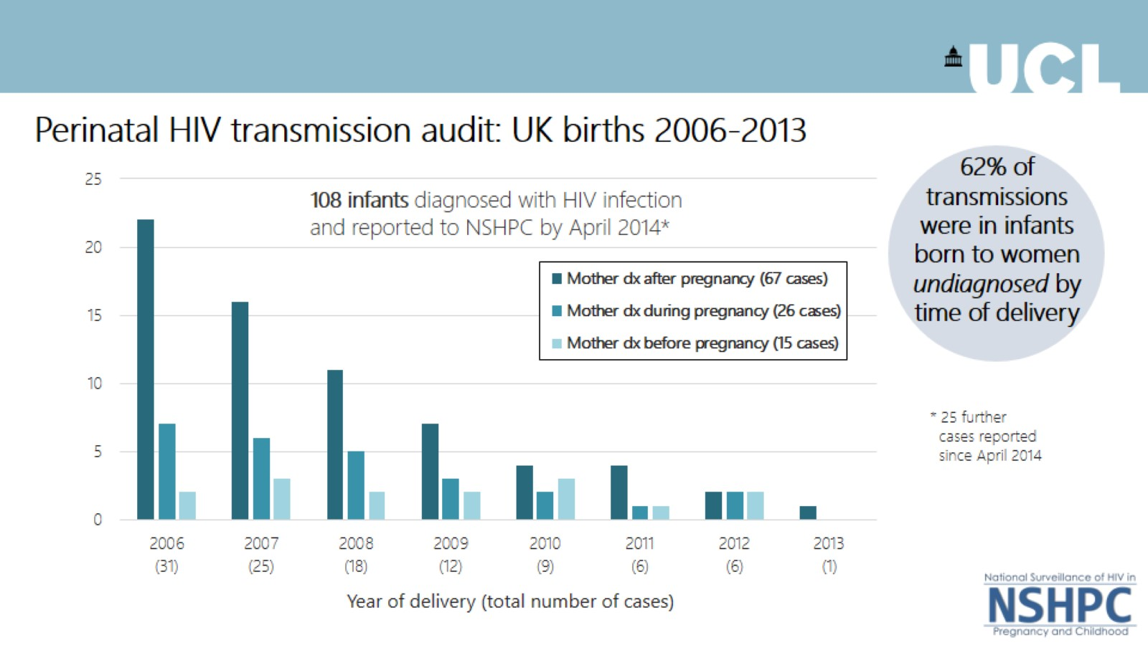

Slide 15

HIV
Find and treat
U =U
Universal ante-natal testing &
ART
ART PEP
0.1 % transmission

Slide 16
 | HIV | Hep B
Antenatal seroprevalence | 0.1-0.2% | 0.3-0.4%
Routine antenatal screening | ✓ | ✓
Transmission rate s intervention | 20-40% | Up to 90%
Chronicity vs adult acquisition | 100% vs 100% | 90% vs 5%
Effective MTCPT | ✓ | ✓
Transmission rate post MTCPT | 0.1% | <1%*
Curative treatment | ✗ | ✗
Immunisation | ✗ | ✓
Hep B

Slide 17
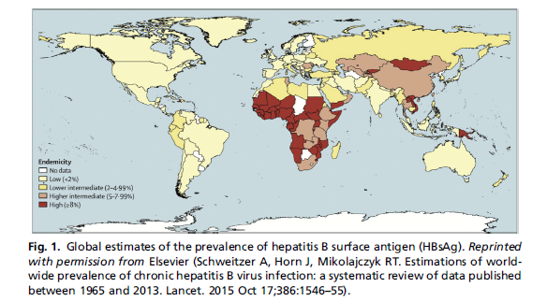
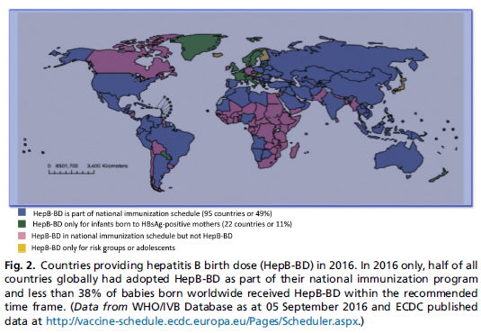

Slide 18
Transmission
eAg+ mother – 70-90%
eAg- mother – 10%
Administration of vaccine alone offers up to 80% protection to infants of eAg+ mothers
Addition of HBIG offers up to 90% protection
Immunoprophylaxis fails in 10-30% of infants born to mums with a HBV DNA > 6log10
- high viral load
- intrauterine transmission
- genotype C
- vaccine hyporesponsiveness
- escape mutants

Slide 19


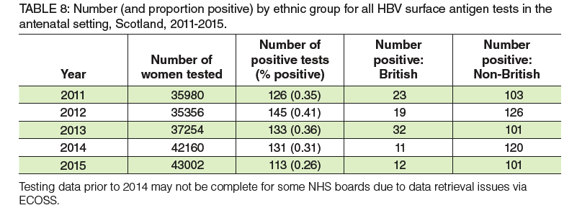
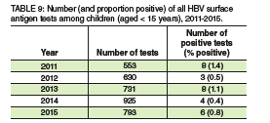

Slide 20
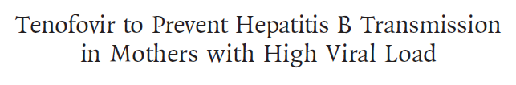
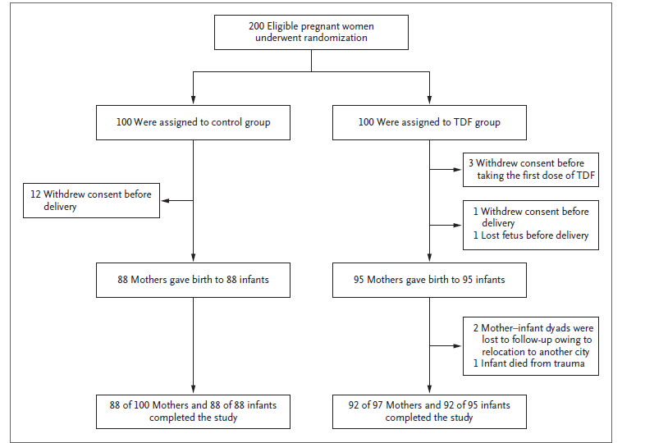
Pan CQ et al. N Engl J Med 2016;374:2324-2334.

Slide 21
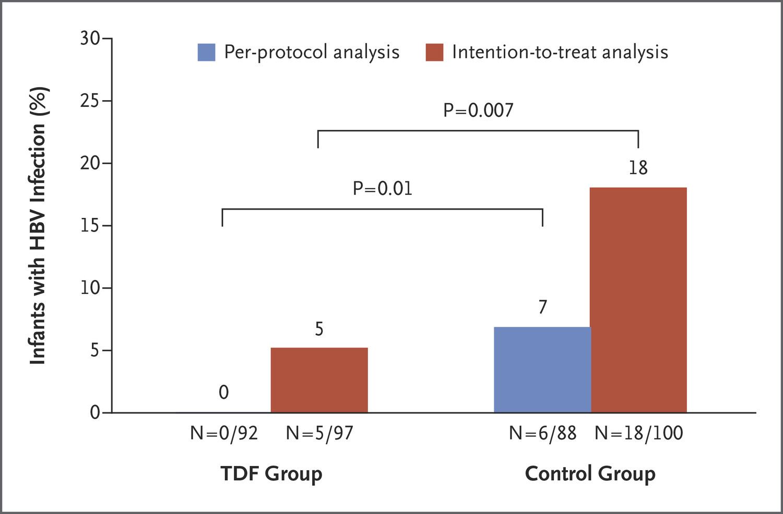

Pan CQ et al. N Engl J Med 2016;374:2324-2334.
Rate of Hepatitis B Virus (HBV) Infection among Infants.
Notes:
Figure 2. Rate of Hepatitis B Virus (HBV) Infection among Infants. The intention-to-treat analysis included the infants born to all enrolled participants except for women who withdrew consent before the initiation of treatment. The per-protocol analysis excluded infants born to women who withdrew consent, were lost to follow-up, or discontinued treatment for any reason.

Slide 22
Hep B
Immunise
Nucleotide analogue
e.g. tenofovir
Passive & active immunisation
?<1 % transmission

Slide 23
Hep C
 | HIV | Hep B | Hep C
Antenatal seroprevalence | 0.1-0.2% | 0.3-0.4% | 0.3-0.4%
Routine antenatal screening | ✓ | ✓ | ✗
Transmission rate s intervention | 20-40% | Up to 90% | 2-5%
Chronicity vs adult acquisition | 100% vs 100% | 90% vs 5% | 80% vs 75%
Effective MTCPT | ✓ | ✓ | ✗
Transmission rate post MTCPT | 0.1% | <1%* | n/a
Curative treatment | ✗ | ✗ | ✓
Immunisation | ✗ | ✓ | ✗

Slide 24
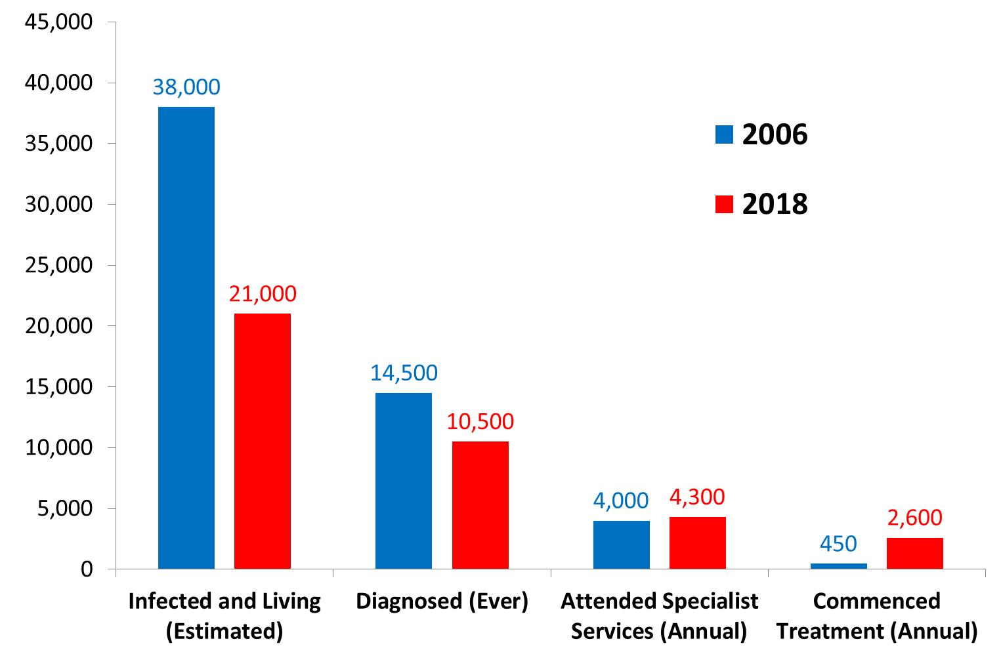
HCV – the epidemiogical picture in Scotland overall (adults & children)
2006
2018
Case finding/Re-engagement effort underway to identify undiagnosed and lost-to-follow-up, approximately one third of whom are women
Number living with chronic HCV infection
~10,500 undiagnosed
~6,000 not in care

Slide 25
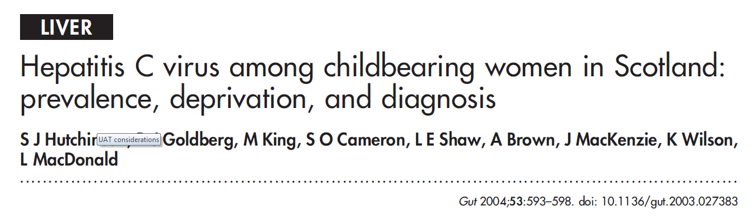
Anonymous testing of neonatal samples (Guthrie cards) from March-October 2000
121/30,259 repeat reactive for HCV Ab on ELISA
  88/30,259 were confirmed HCV Ab+ on RIBA
= HCV Ab prevalence of 0.29%-0.40%

Slide 26
How many children are likely to be undiagnosed in Scotland?
0.29% - 0.4% HCV antibody prevalence among childbearing women*
(~0.23%-0.32% chronic prevalence)
56,000 live births per year
X
130-180 births to HCV carrier mothers per year
Assuming 3%-8% risk of vertical transmission
4-14 HCV infected children born per year
66-240 HCV infected children
(currently aged<18)
=
0% - 70% undiagnosed
*Hutchinson et al. Hepatitis C virus among childbearing women in Scotland: prevalence, deprivation and diagnosis. Gut (2014)

Slide 27
2011 UK national screening committee - antenatal Hep C screening
Universal screening for hepatitis C in pregnancy is not recommended
There are currently no interventions which have been shown to significantly reduce the risk of transmission to the baby. In addition there is insufficient information on the prevalence of hepatitis C in the pregnant population and on the natural history of vertically acquired infection.
Recent developments in the treatment of hepatitis C have changed the terms of the debate about screening for hepatitis C in pregnancy. However the effectiveness of new treatment regimens in the paediatric population, and their impact on the assessment of screening, are currently insufficiently understood to recommend that all pregnant women should be offered screening

Slide 28
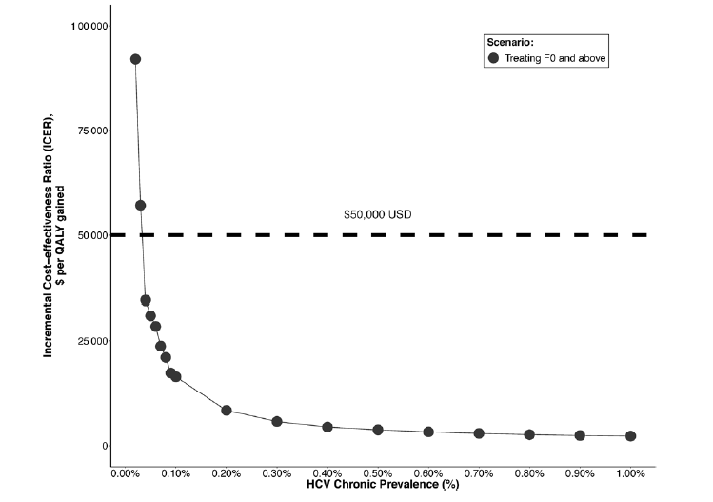
Figure from Chaillon et al. Cost-effectiveness of Universal Hepatitis C Virus Screening of Pregnant Women in the United States. Clin Infect Dis 2019.
Antenatal screening: Cost effectiveness
Cost effectiveness of antenatal screening
Antenatal screening was found to be cost effective
Assumptions:
Women are treated after pregnancy
Chronic HCV prevalence of 0.73% among pregnant women (but screening remained cost effective at 0.07%)
Treatment costs of $25,000/treatment

Slide 29
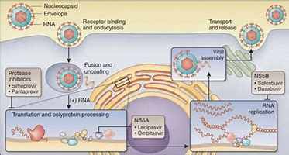

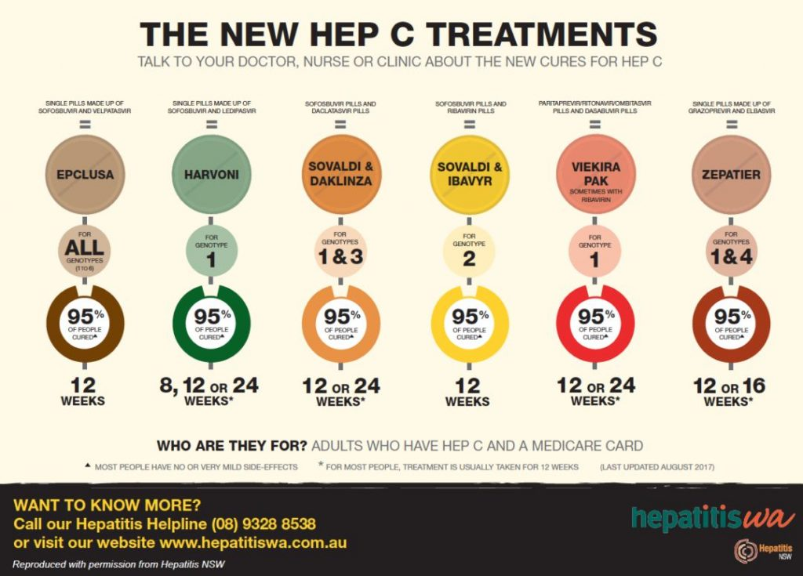
Hep C treatment

Slide 30
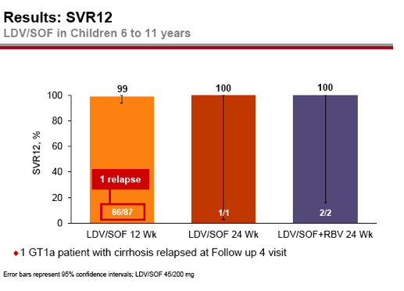
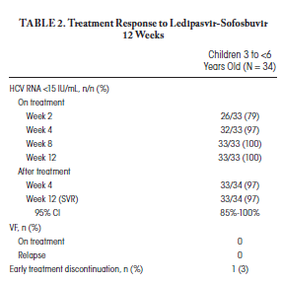
Paediatric licenses: Harvoni 12-18 years
Licensed 2017 for 12-18 years >35kg
Overall SVR 98%
Well tolerated
8 weeks in non cirrhotic patients
Genotype 1 and 4
Hepatology. 2018 Dec;68(6):2158-2166

Slide 31
Hep C
?
?
‘find and cure’
‘find and cure’

Slide 32
cCMV

Slide 33
 | HIV | Hep B | Hep C | cCMV
Antenatal seroprevalence | 0.1-0.2% | 0.3-0.4% | 0.3-0.4% | 40-90%
Routine antenatal screening | ✓ | ✓ | ✗ | ✗
Transmission rate s intervention | 20-40% | Up to 90% | 2-5% | 30-40% T1,2 40-70% T3 Non-prim 3%
Chronicity vs adult acquisition | 100% vs 100% | 90% vs 5% | 80% vs 75% | 100% vs 100%
Effective MTCPT | ✓ | ✓ | ✗ | ✗
Transmission rate post MTCPT | 0.1% | <1%* | n/a | n/a
Curative treatment | ✗ | ✗ | ✓ | ✗
Immunisation | ✗ | ✓ | ✗ | ✗

Slide 34
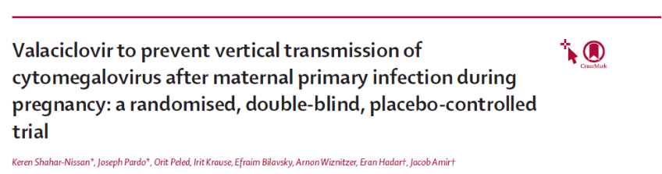
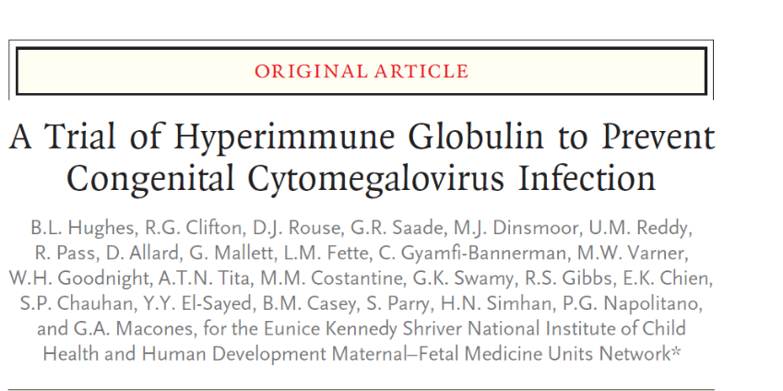


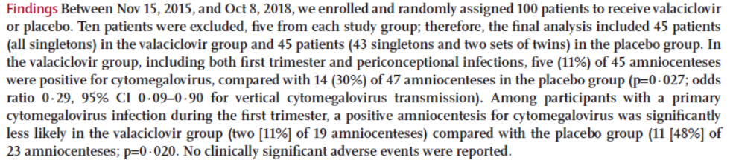
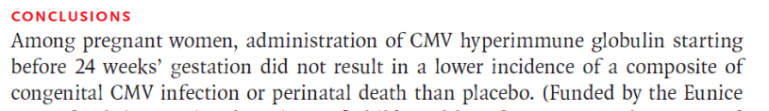
CMV – prevention of transmission

Slide 35
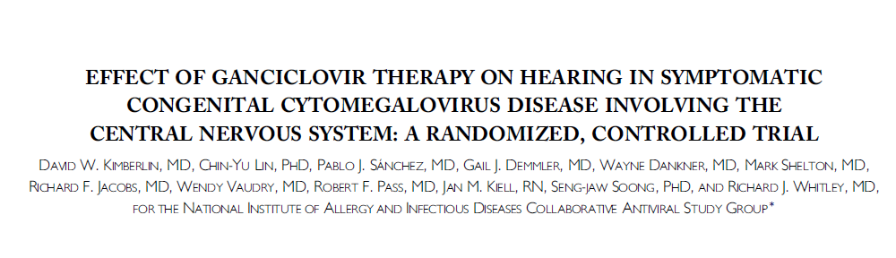
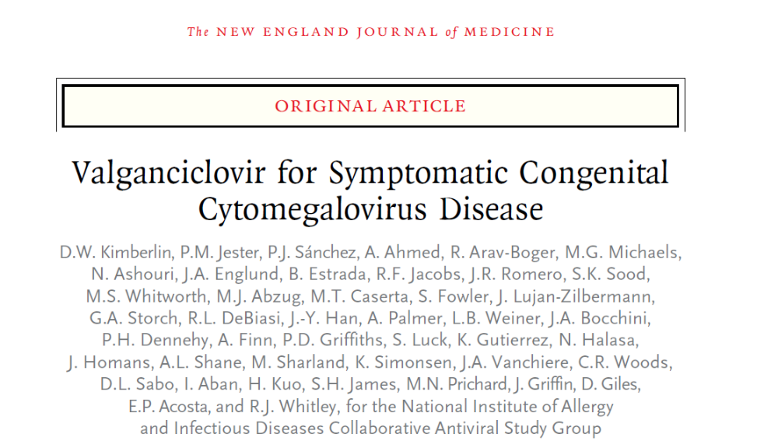

cCMV treatment of infected babies
J Paediatr 2003

Slide 36

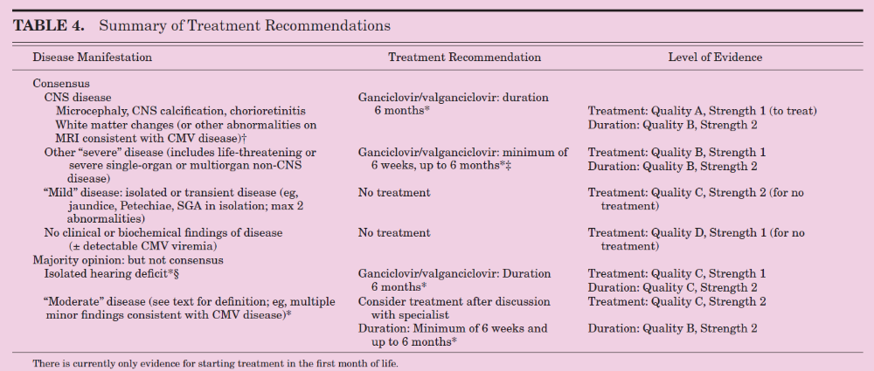
Indications for treatment

Slide 37
CMV
Vaccination
Hyperimmune globulin ✗
Antiviral ?
Hygiene interventions
Valganciclovir treatment - select patients
? age of start
? how long

